Slide 1



Slide 2



CODE WITH KEN
Getting started with
Git and GitHub
@loveneeshdhir
Loveneesh Dhir

Slide 3


Before we start...
Git Installed
GitHub account Your favorite editor

Slide 4





Workshop Flow
My ﬁrst git: What is Git and GitHub?
git good: Git Fundamentals 101
git explore: Explore the GitHub Universe
open sourcing: Doing some good for the tech community

Slide 5

My First Repo!
What is Git and GitHub?

Slide 6

What is Git?
" The stupid content tracker “
"Global Information Tracker":
you're in a good mood, and it actually works for you. Angels sing, and a light suddenly ﬁlls the room.
"Goddamn Idiotic Truckload of sh*t": when it breaks

Slide 7

So, What is Git?
A Distributed Version Control System.
Any project which uses Git will have a .git folder which stores all the history of the project.

Slide 8



History:
Know exactly which ﬁles changed, who made those changes, and when those changes occured.
Backup:
Ability to have different versions of the code in different places.
Collaboration:
Collaborate easily with other people on the same project by uploading and receiving changes

Slide 9

What is GitHub?
GitHub is a website that allows us to use git and create repositories online. It can also store all your projects online for free.

Slide 10
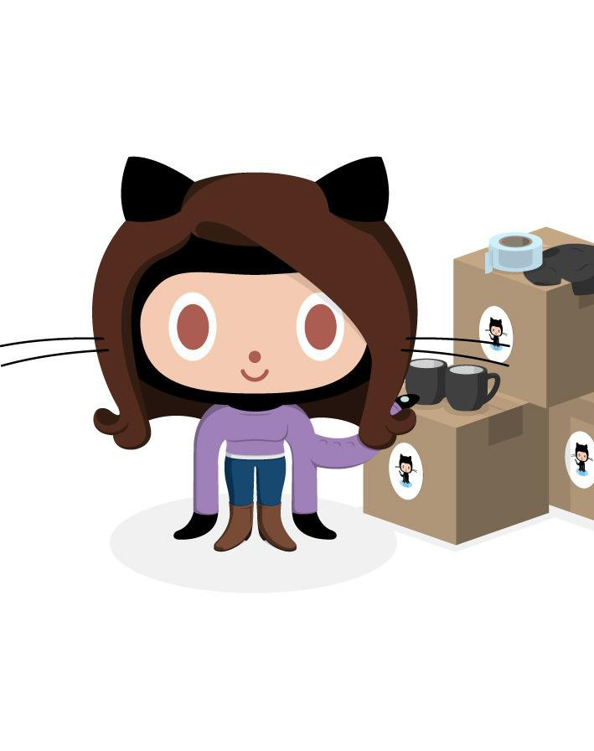
What is a repository?
A repository is a container that houses your project and its’ history. If your project folder contains the “.git” folder you’re working with a repository!

Slide 11




If you are on windows, open Git-Bash.
Let’s get started!
If you are on linux or Mac, ﬁre up a terminal.

Slide 12
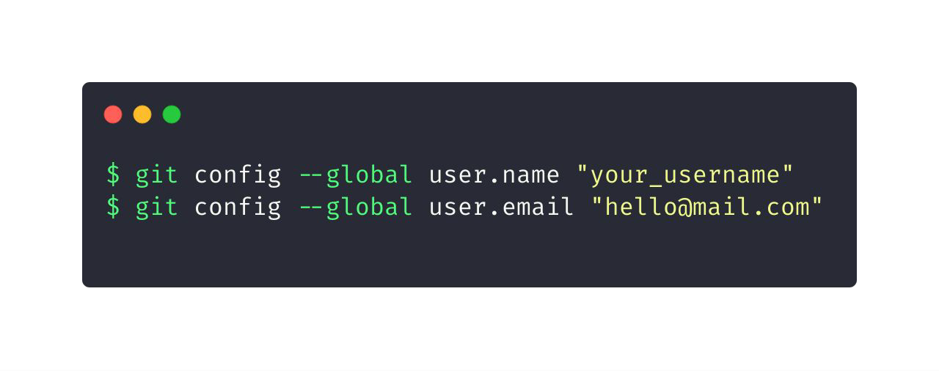
Let git know who you are
GitHub uses the email address set in your local Git conﬁguration to associate commits pushed from the command line with your GitHub account.

Slide 13
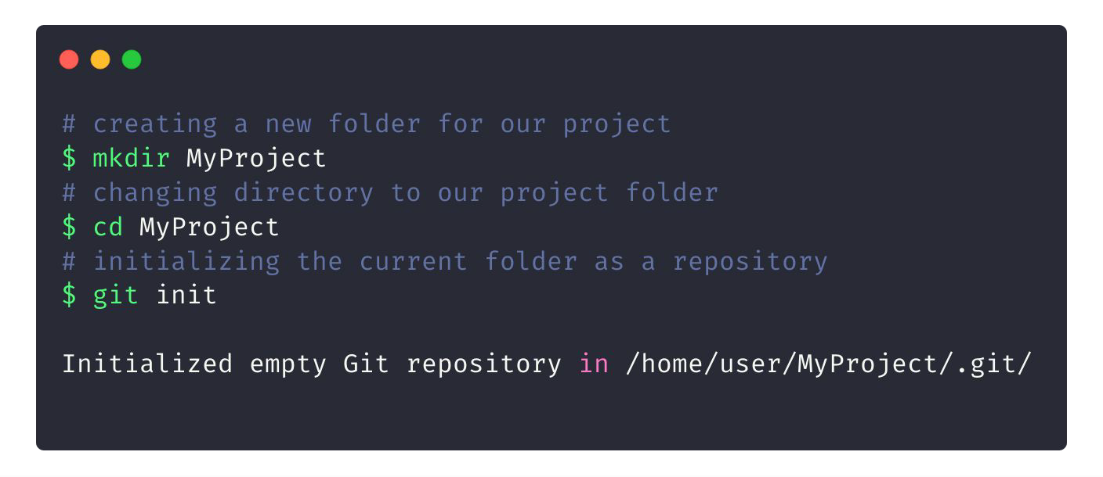
Initializing a new repository

Slide 14

Commits
Checkpoints/Snapshot of the state of your repository (project) at a particular time.

Slide 15
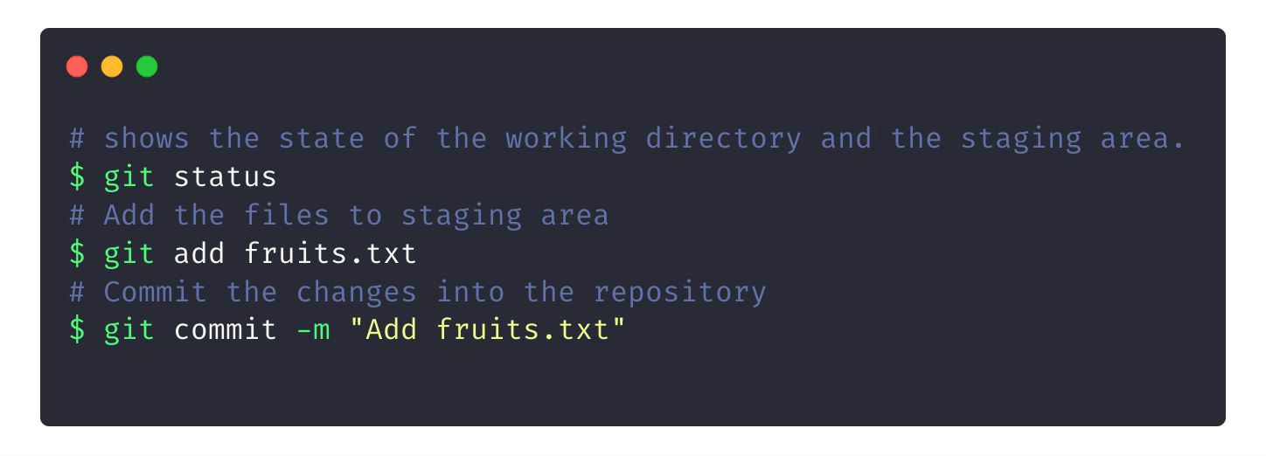
Creating your ﬁrst commit

Slide 16
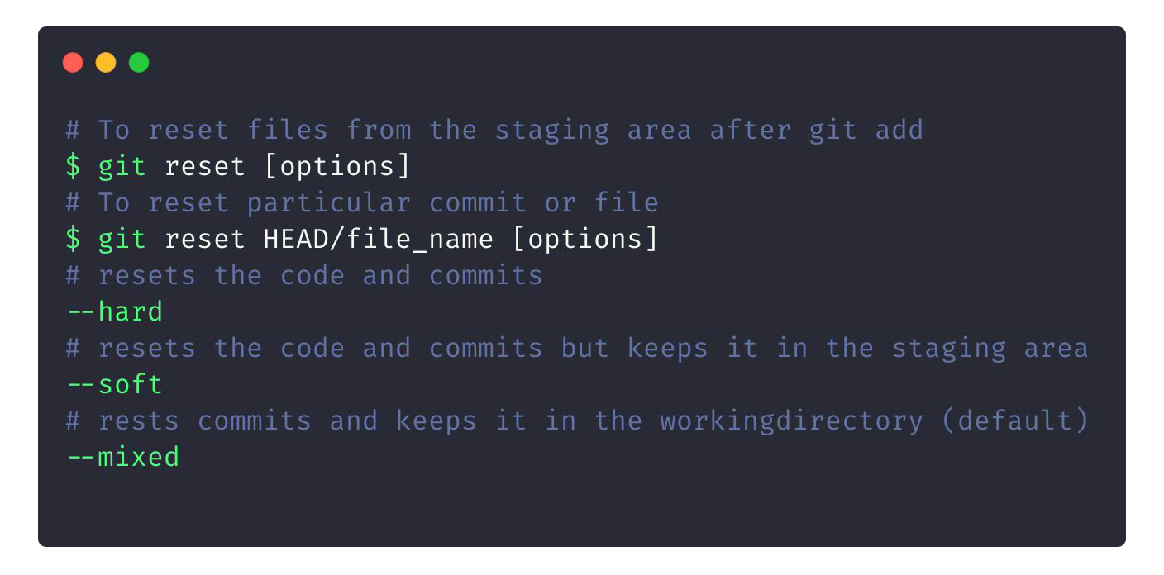
To Reset your Commits

Slide 17

Working with GitHub and fundamentals of Git 101.
Git Good!

Slide 18
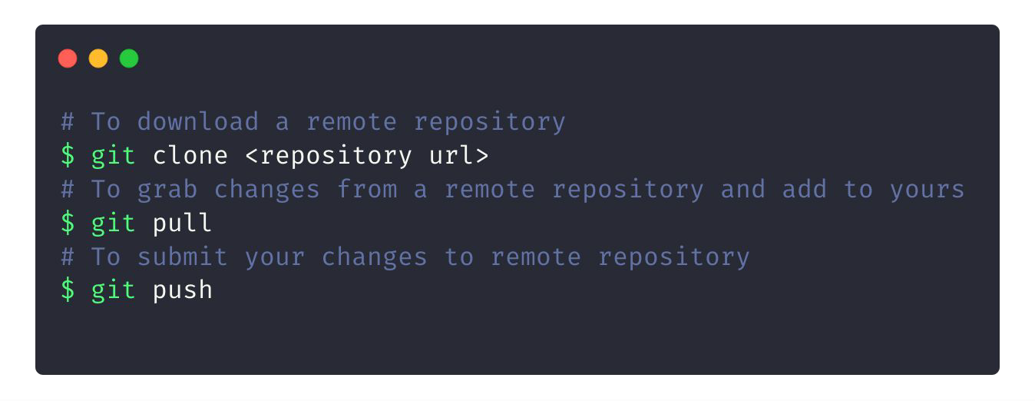
Downloading/Updating repos

Slide 19
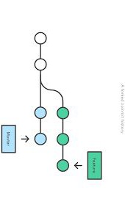
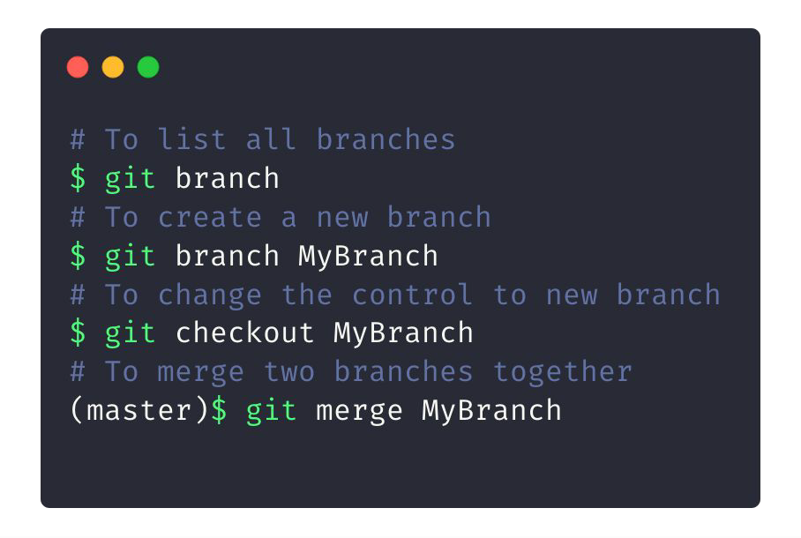
Git Branches

Slide 20
Time for some hands on!
https://tosr.netlify.com

Slide 21

What can we do with GitHub?
Well, what not?

Slide 22





Education
GitHub
Programs and technology leadership at your school
Campus Advisors

Slide 23



Events on GitHub

